Slide 1
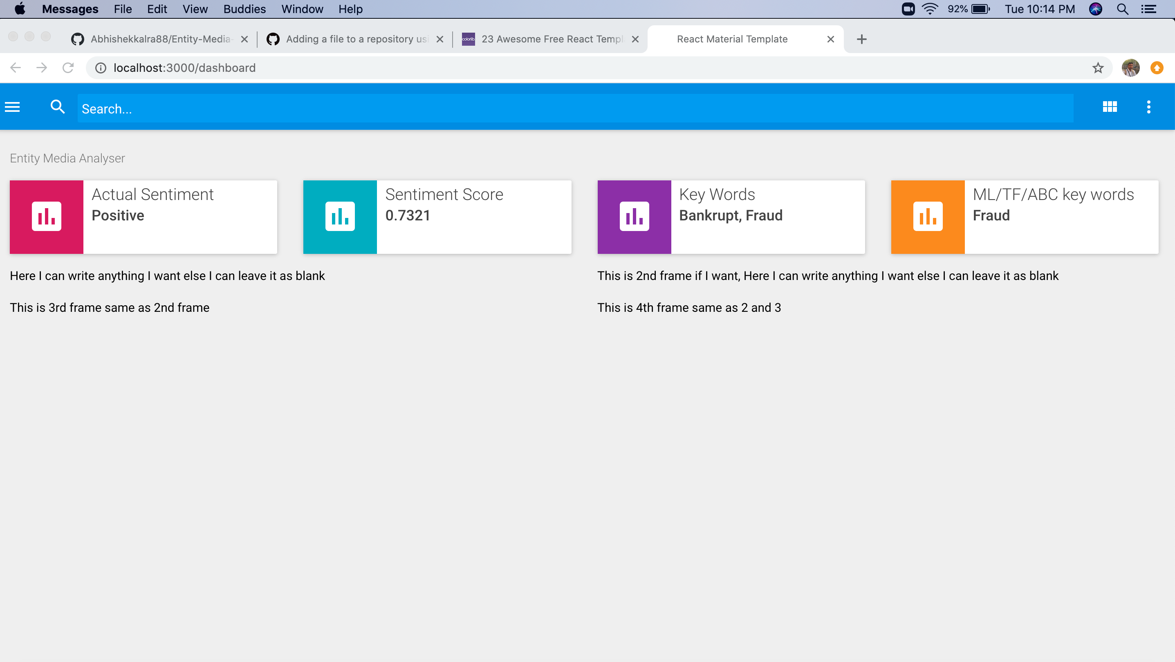
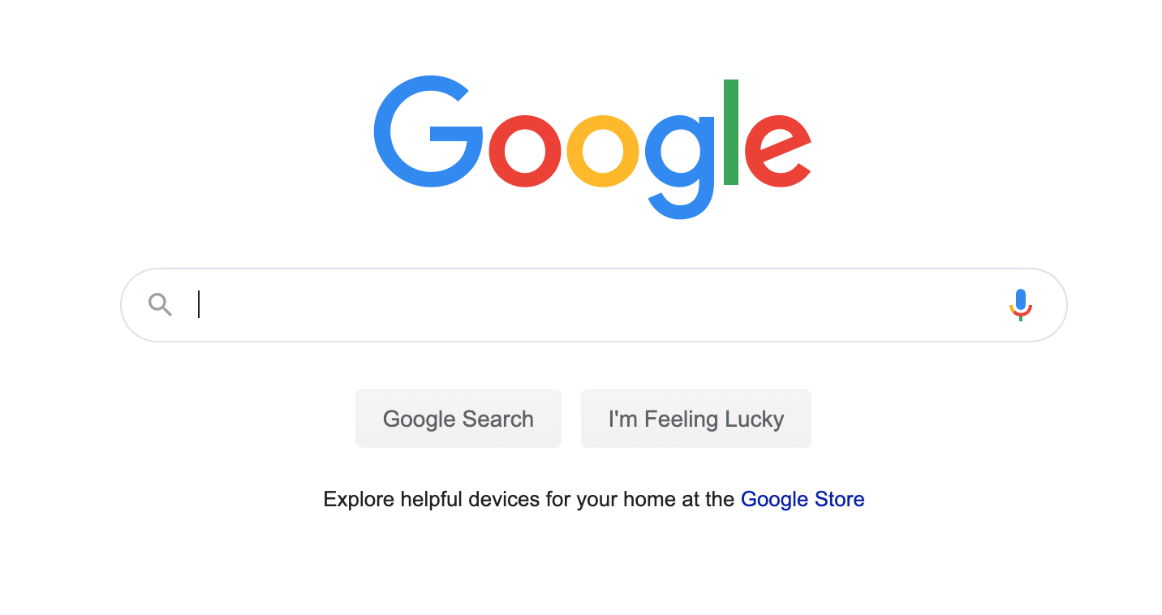
Amazon Cloud
Looks up the query in database, If it does not exists executes the search. If it does retrieves
Front End
React
Request
Response
Search in Google through python
Database - Sqllite

